Slide 1
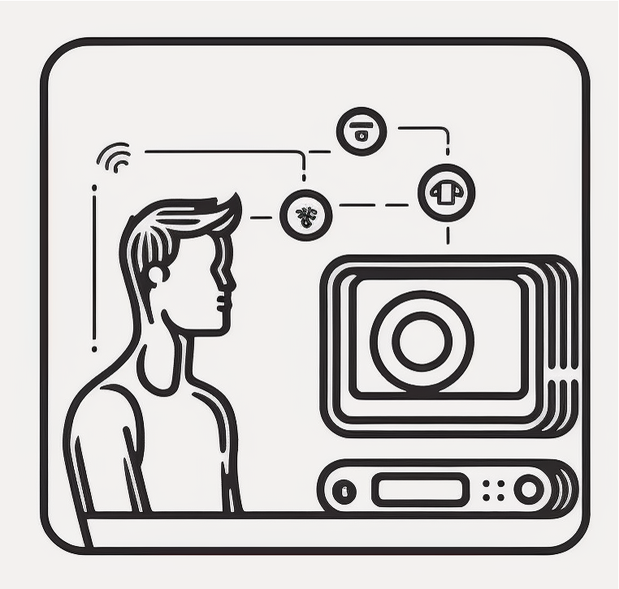




AMIR: Active Multimodal Interaction Recognition from Video and Network Traffic in Connected Environments
Shinan Liu, Tarun Mangla, Ted Shaowang, Jinjin Zhao,
John Paparrizos, Sanjay Krishnan, Nick Feamster

Slide 2



Activity Recognition using Video
Elder care
Surveillance
Home Automation
Notes:
Interactions with devices take up xx hour of work.
Pet care.

Slide 3
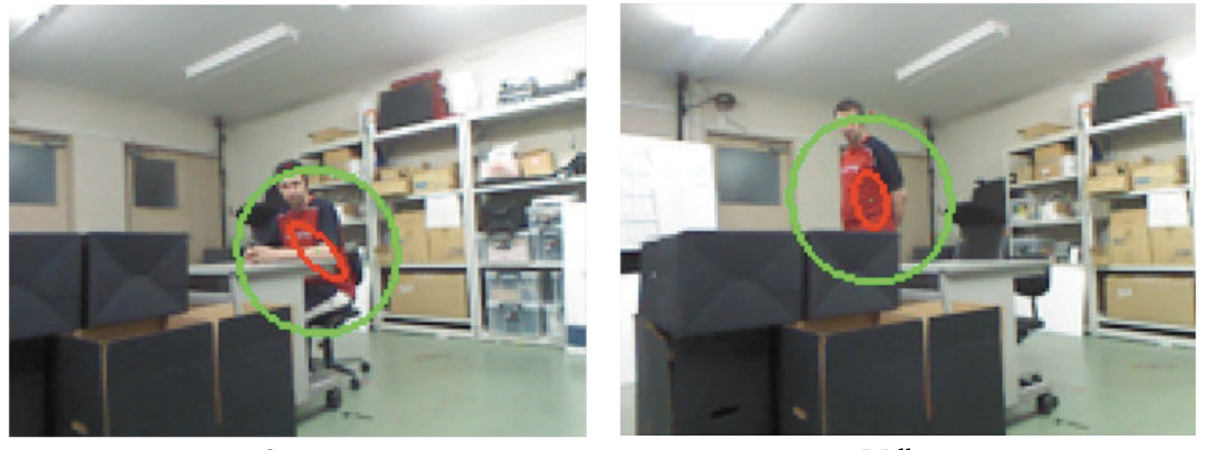
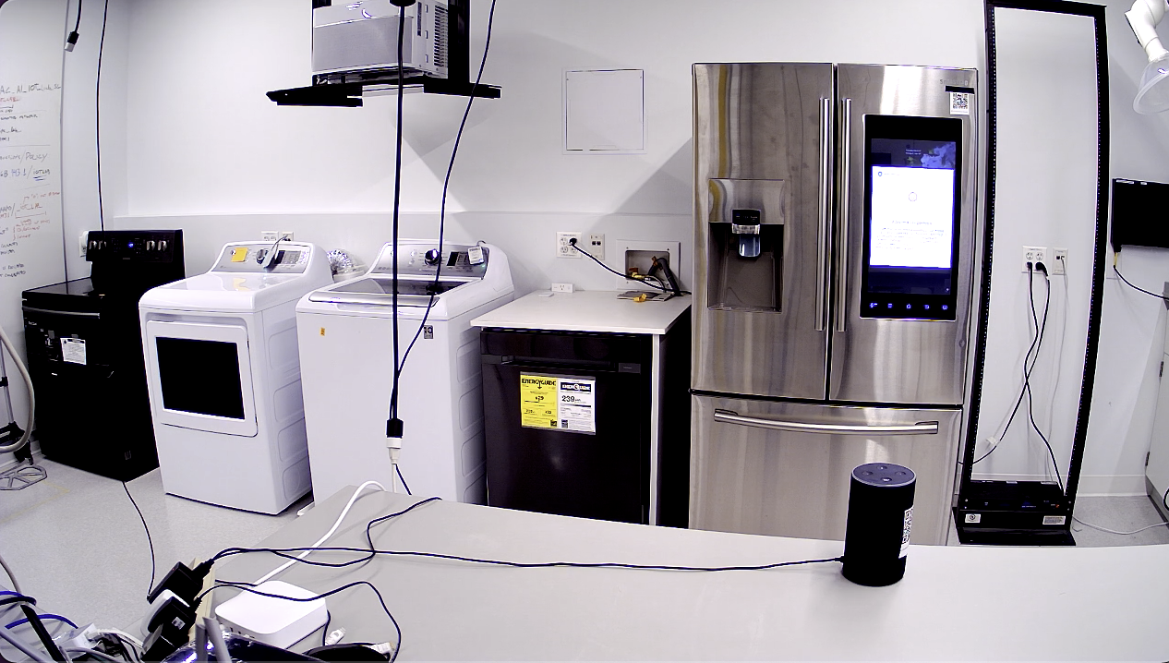
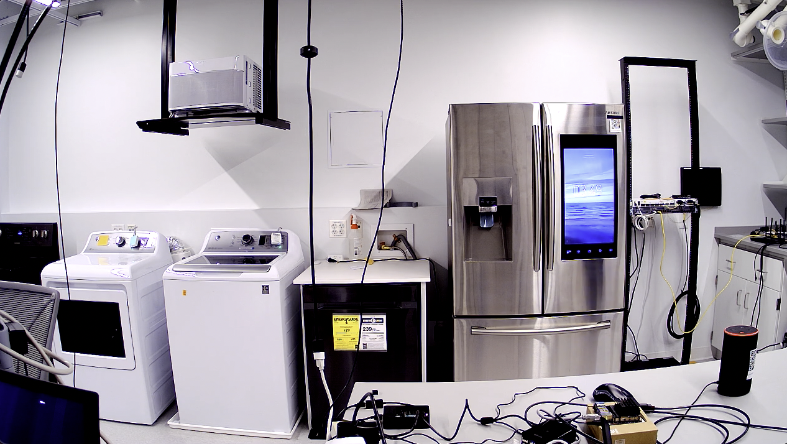
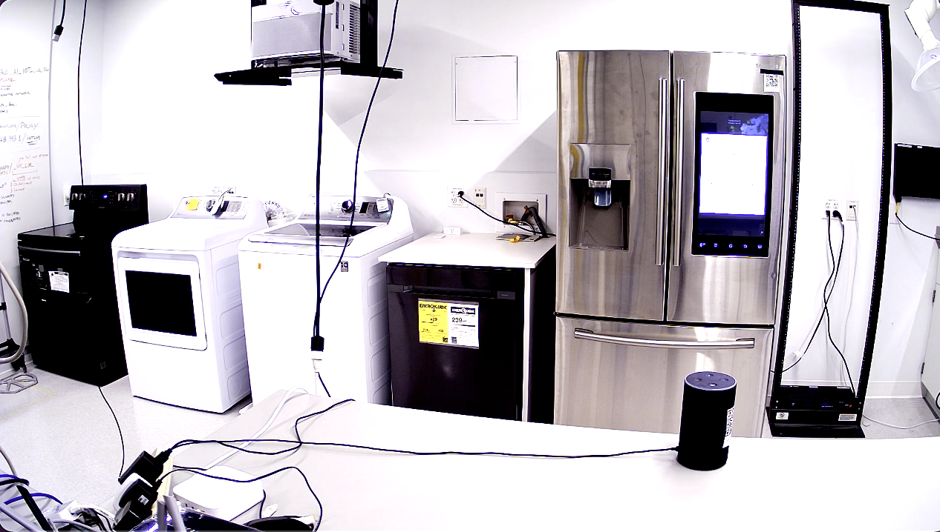
Video classifiers can be brittle.
Statistical failures
Activities often have “long tail”
Line of sight (fundamental)
Occlusions
Obstructions
Camera angle
Bad lighting
…
Notes:
Although computer vision models are increasingly becoming powerful.
environement and users

Slide 4
How to augment visual activity recognition with alternate data?
The proliferation of Networked devices complements Videos for recognition.
Notes:
Capturing network traffic does not require specialized sensing hardware and can be deployed in any home environment
More ubiquitous than other sensors
It is agnostic to the physical arrangement of activity recognition objects and subjects

Slide 5


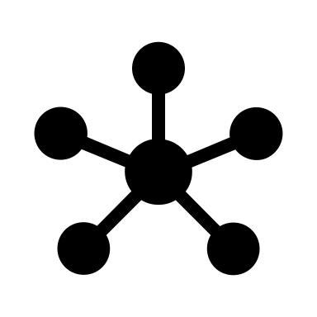
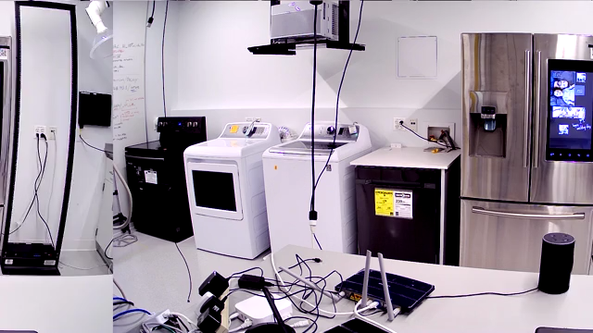
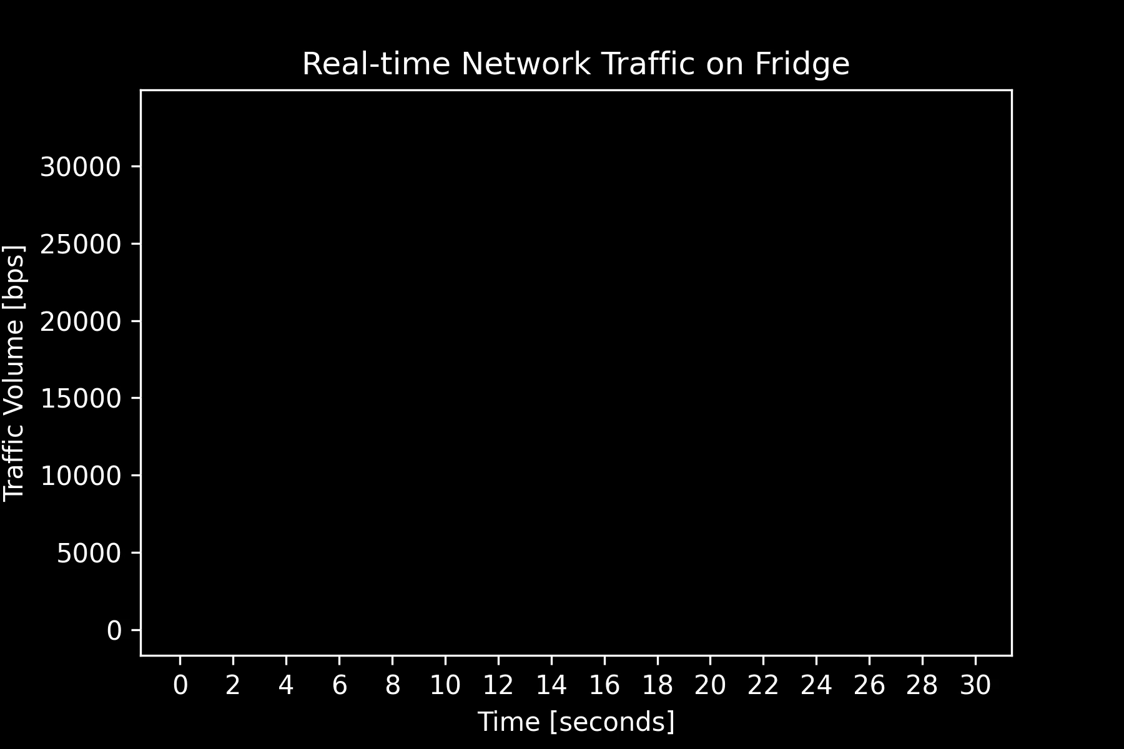
Notes:
throughput

Slide 6
How to augment visual activity recognition with alternate data?
The proliferation of Networked devices complements Videos for recognition.
General-purpose hardware
Cyber vs. physical
Notes:
Capturing network traffic does not require specialized sensing hardware and can be deployed in any home environment
More ubiquitous than other sensors
It is agnostic to the physical arrangement of activity recognition objects and subjects.
Generalizable across environments. Video generalizes across Devices.

Slide 7
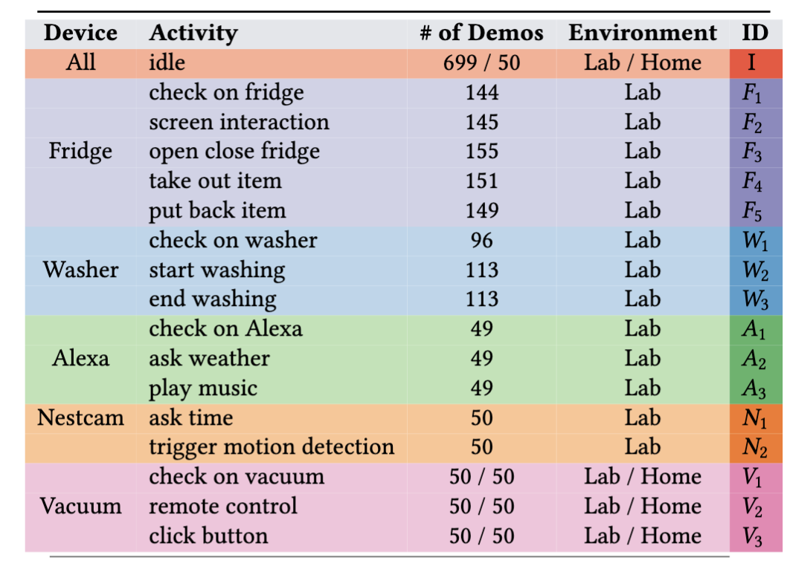
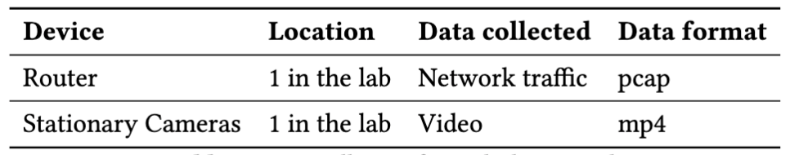
IoTLab & Dataset (Open-Sourced)
2160 pairs of collection, about 36 human hours pure data, 7 participants
Notes:
Hundreds of hours curating this dataset.
18 classes

Slide 8
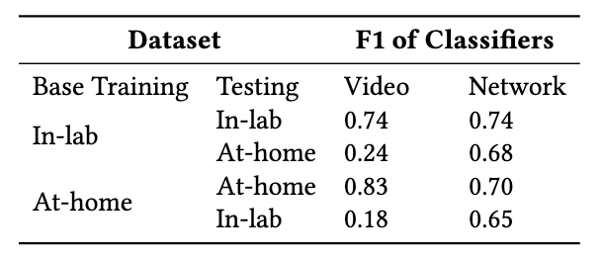
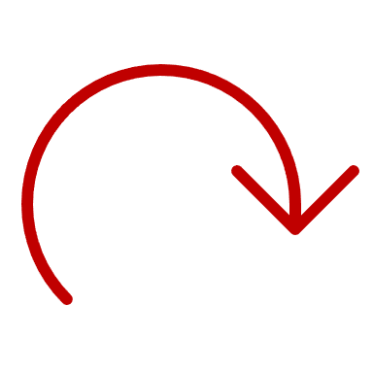
Network is reliable when physical surroundings change.
Notes:
Too much to look at
Sub figure
Barchart

Slide 9
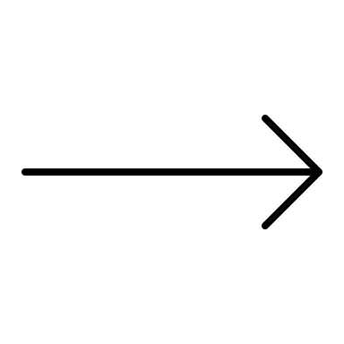

Combining two models is non-trivial.
Pretrained Video Model
?
Activity
Network Traffic Model
Notes:
Feature fusion
-> requires ALL samples to be paired
Soft voting
-> fails when one model is broken
Stacking
-> requires SOME paired samples
Non-trivial problem, how to synthesize
Visualize it?
Graphically show it

Slide 10

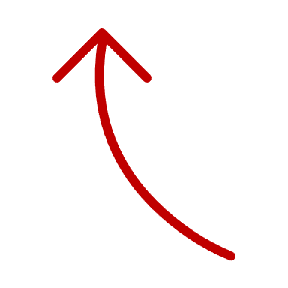
Combining two models is either costly or inaccurate.
Pretrained Video Model
Video Features
Activity
Uniform Model
Feature Fusion
Network Traffic Model
Network Features
Requires ALL paired collections for retraining.
Notes:
Feature fusion
-> requires ALL samples to be paired
Soft voting
-> fails when one model is broken
Stacking
-> requires SOME paired samples
Non-trivial problem, how to synthesize
Visualize it?
Graphically show it

Slide 11

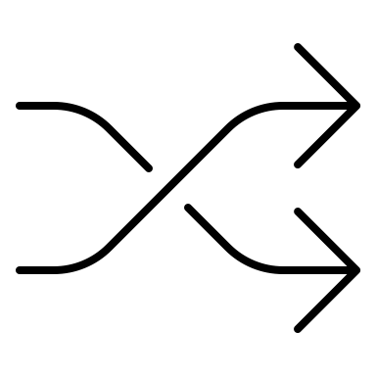
Combining two models is either costly or inaccurate.
Pretrained Video Model
Activity Vid
Vote By Weights
Activity
Activity Net
Network Traffic Model
Fails when one model is broken.
Notes:
Feature fusion
-> requires ALL samples to be paired
Soft voting
-> fails when one model is broken
Stacking
-> requires SOME paired samples
Non-trivial problem, how to synthesize
Visualize it?
Graphically show it

Slide 12

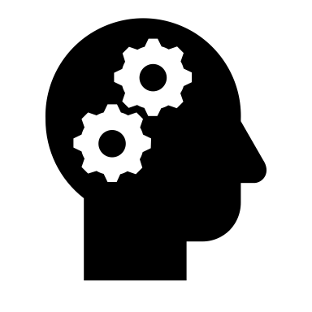

Combining two models is either costly or inaccurate.
Pretrained Video Model
Output Vid
Stacking
Model
Activity
Output Net
Network Traffic Model
Requires SOME paired collections for stacking model.
Notes:
Feature fusion
-> requires ALL samples to be paired
Soft voting
-> fails when one model is broken
Stacking
-> requires SOME paired samples
Non-trivial problem, how to synthesize
Visualize it?
Graphically show it

Slide 13
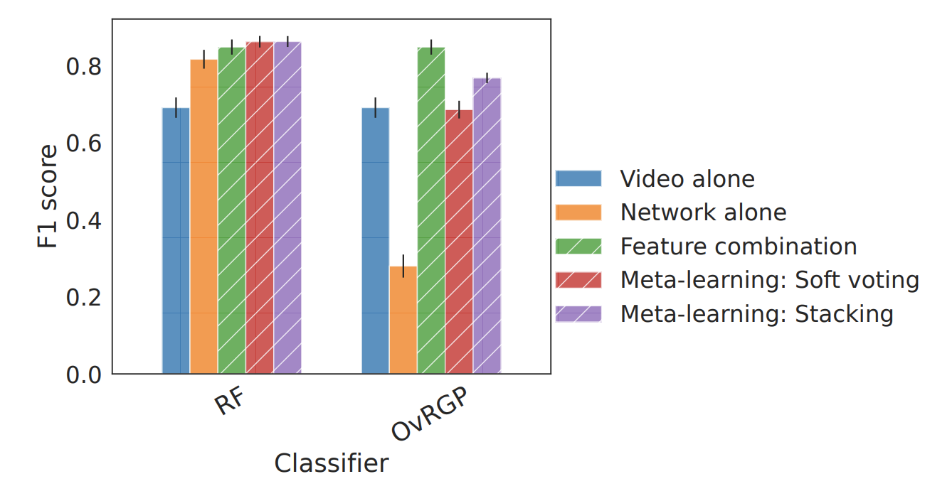
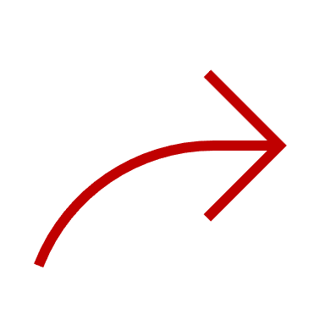
Stacking is the way to go for efficient combinations of two models.
87% less paired collections
Video Alone
Network Alone
Feature Fusion
Voting
Stacking
Notes:
12 class
Barchart

Slide 14

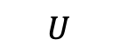
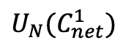
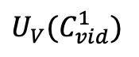
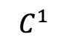
How to collect the least possible paired observations? Use AMIR!
Idea: paired collections are most valuable in classes where both models are uncertain about their predictions.
$$U_{V}(C_{vid}^{1})$$
$$C^{1}$$
0.4
Pretrained Video Model
$$U$$
Output Vid
0.5
Validation Pairs from
ANY Environment
$$U_{N}(C_{net}^{1})$$
0.6
Output Net
Network Traffic Model
Notes:
Not clear enough. nuggets,
why we have strawman
The idea behind paired observation prioritization is to "cherry-pick" the best group of data for training the
stacking meta-learner. By this intentionally "biased" collection method, the saturation of F1 score is achieved
earlier and may potentially end in a higher level.
our uncertainty-based method derives the weights of classes for data collection, from information that is available in the individual model training process. These weights determine the priority of paired collection, i.e., the top weighted class is collected first and with the largest amount.
To derive the weights, we assume that we already have trained models for video and network data respectively. Paired examples are most valuable in classes where neither model is very confident in its prediction.
The class uncertainty score is aggregated across all samples for each model first, and then averaged/normalized between models later.

Slide 15
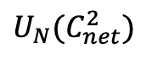
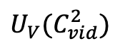
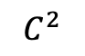
How to collect the least possible paired observations? Use AMIR!
Idea: paired collections are most valuable in classes where both models are uncertain about their predictions.
$$U_{V}(C_{vid}^{2})$$
$$C^{2}$$
0.3
Pretrained Video Model
$$U$$
Output Vid
0.5
0.3
Validation Pairs from
ANY Environment
$$U_{N}(C_{net}^{2})$$
0.3
Output Net
Network Traffic Model
Notes:
Not clear enough. nuggets,
why we have strawman
The idea behind paired observation prioritization is to "cherry-pick" the best group of data for training the
stacking meta-learner. By this intentionally "biased" collection method, the saturation of F1 score is achieved
earlier and may potentially end in a higher level.
our uncertainty-based method derives the weights of classes for data collection, from information that is available in the individual model training process. These weights determine the priority of paired collection, i.e., the top weighted class is collected first and with the largest amount.
To derive the weights, we assume that we already have trained models for video and network data respectively. Paired examples are most valuable in classes where neither model is very confident in its prediction.
The class uncertainty score is aggregated across all samples for each model first, and then averaged/normalized between models later.

Slide 16
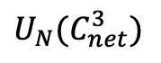
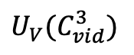
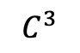
How to collect the least possible paired observations? Use AMIR!
Idea: paired collections are most valuable in classes where both models are uncertain about their predictions.
$$U_{V}(C_{vid}^{3})$$
$$C^{3}$$
0.3
Pretrained Video Model
$$U$$
Output Vid
0.5
0.3
$$U_{N}(C_{net}^{3})$$
0.2
Validation Pairs from
ANY Environment
0.1
Output Net
Network Traffic Model
Notes:
Not clear enough. nuggets,
why we have strawman
The idea behind paired observation prioritization is to "cherry-pick" the best group of data for training the
stacking meta-learner. By this intentionally "biased" collection method, the saturation of F1 score is achieved
earlier and may potentially end in a higher level.
our uncertainty-based method derives the weights of classes for data collection, from information that is available in the individual model training process. These weights determine the priority of paired collection, i.e., the top weighted class is collected first and with the largest amount.
To derive the weights, we assume that we already have trained models for video and network data respectively. Paired examples are most valuable in classes where neither model is very confident in its prediction.
The class uncertainty score is aggregated across all samples for each model first, and then averaged/normalized between models later.

Slide 17
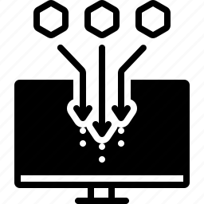
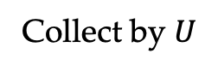
How to collect the least possible paired observations? Use AMIR!
Idea: paired collections are most valuable in classes where both models are uncertain about their predictions.
$$U$$
5 3 2
Pretrained Video Model
Output Vid
0.5
0.3
0.2
Validation Pairs from
ANY Environment
Collect by $U$
Output Net
Network Traffic Model
Notes:
Not clear enough. nuggets,
why we have strawman
The idea behind paired observation prioritization is to "cherry-pick" the best group of data for training the
stacking meta-learner. By this intentionally "biased" collection method, the saturation of F1 score is achieved
earlier and may potentially end in a higher level.
our uncertainty-based method derives the weights of classes for data collection, from information that is available in the individual model training process. These weights determine the priority of paired collection, i.e., the top weighted class is collected first and with the largest amount.
To derive the weights, we assume that we already have trained models for video and network data respectively. Paired examples are most valuable in classes where neither model is very confident in its prediction.
The class uncertainty score is aggregated across all samples for each model first, and then averaged/normalized between models later.

Slide 18
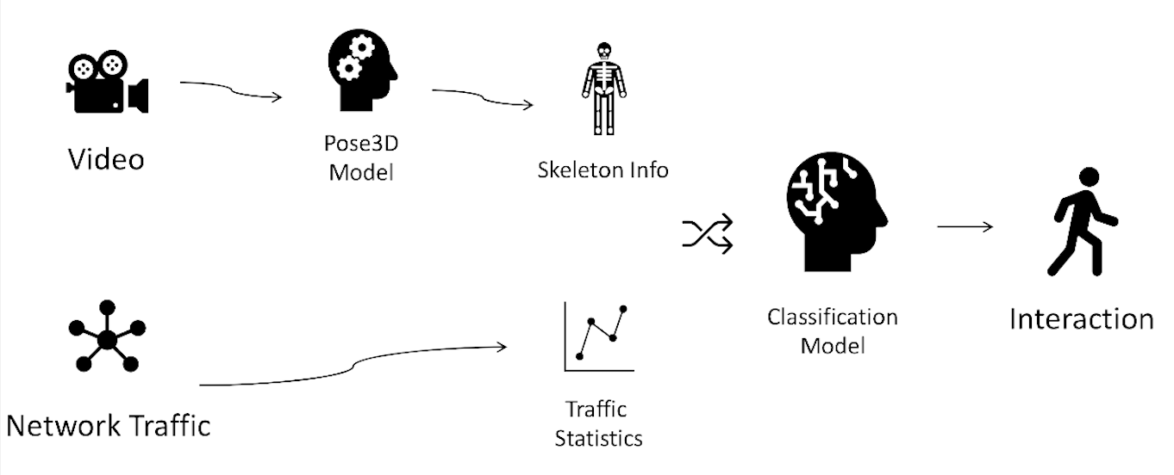
Modeling
Notes:
network package trace

Slide 19
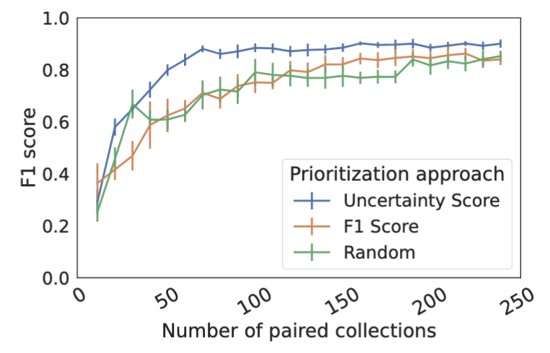
Uncertainty-based collection with AMIR is a very efficient
120 (∼3 hours of human labor) less samples are needed compared to random selection for saturation.
120 pairs
5%
Notes:
uncertainty-based class distribution is the fastest to saturate (70 and 130 samples, respectively for 12-calss and
14-class problem) and gain the highest F1 score (91.8% and 77.9%). Compared to random prioritization with equal
class distributions, 120 (∼2 hours of human labor) and 50 (∼50 minutes of human labor) more samples are needed
for saturation. Meanwhile, uncertainty prioritization achieves higher final F1 scores than the other two methods
by 2% to 3%
Just one

Slide 20
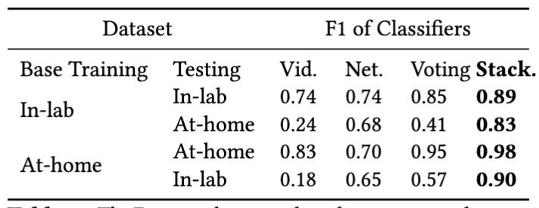
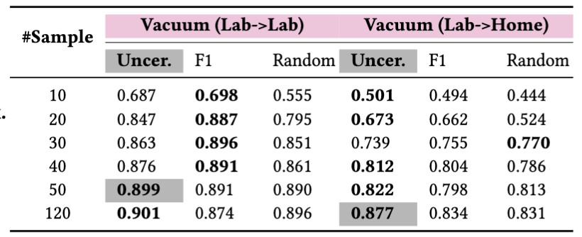
Transferability across environments
Network models are more robust to environmental changes compared to video
Stacking with some paired examples shows adaptive capacities performs the best across environments
The uncertainty-based prioritization of AMIR helps to derive a meta-learner when environments are different.
Notes:
Maybe a takeaway slide?
network is robust to Environmental changes

Slide 21
Takeaways
Network traffic is reliable when physical surroundings change.
Stacking is the way to go for efficient combinations of two models.
AMIR helps to combine two (pre-trained) models with fewer paired samples and achieves better performance.
Notes:
Maybe a takeaway slide?
network is robust to Environmental changes

Slide 22
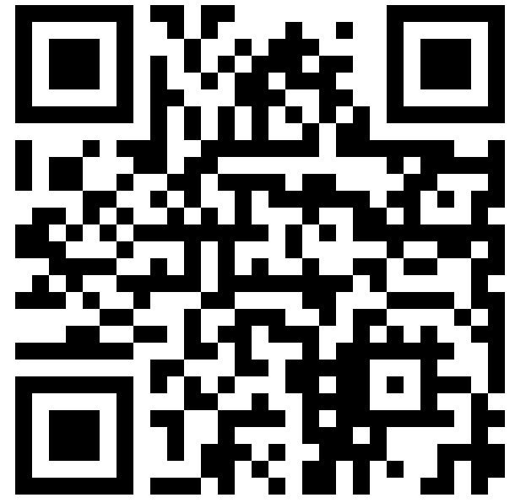
Thanks! We open source all the datasets, features, and models. Please scan QR code to Access.
Shinan Liu, Tarun Mangla, Ted Shaowang, Jinjin Zhao,
John Paparrizos, Sanjay Krishnan, Nick Feamster
Notes:
Takeaways, index pointer for brains.
Combining
Network data is more ubiquitous than people think.

Slide 23
Q & A?
Shinan Liu, Tarun Mangla, Ted Shaowang, Jinjin Zhao,
John Paparrizos, Sanjay Krishnan, Nick Feamster

